Slide 2
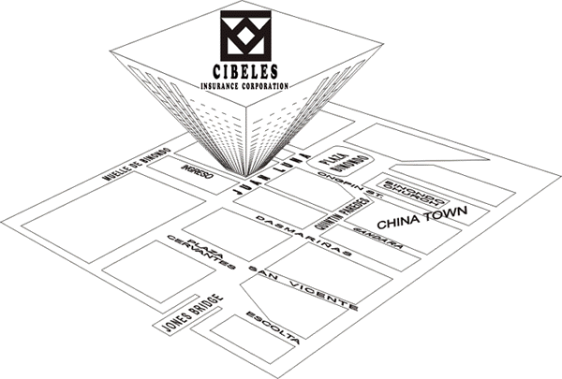
CIBELES OFFICES
Head Office: 6th Floor State Centre Building
333 Juan Luna St. Binondo, Manila
Tel.: 63-2-2421631-40 Fax: 63-2-2420718
Internet: http://www.cibeles.com.ph
Email: info@cibeles.com.ph
Davao Branch
487B Teresita Building
General Luna St. Davao City
Tel.:63-82-2242746
Fax: 63-82-2242745
Calamba Branch
3rd Floor, Sta. Cecilia
Business Center
Brgy. Parian,
Calamba City, Laguna
Tel.:63-49-521-8559
Lipa Branch
Amethyst Bldg., National Rd.
Tambo, Lipa City, Batangas
Tel.:043-341-5425

Slide 3
BOARD OF DIRECTORS
Rufino H. Kopio
Chairman
Members
Le Hun Choa
Ruffy Kopio
Roderick Kopio
Jennifer Kopio
Russell Kopio

Slide 4
CIBELES COMPANY OFFICERS
Chairman and CEO – Rufino H. Kopio
President and COO – Ruffy Kopio, ANZIIF
Executive Vice President – Roderick Kopio, ANZIIF
Senior Vice President and Treasurer – Choa Le Hun
Corporate Secretary – Jennifer Ko Pio
Vice President, Accounting – Sonia Zambrano
Vice President, Underwriting – Joseph Tay
Assistant Treasurer – Russell Kopio
Legal Counsel – Atty. Oscar Pilapil
Davao Branch Manager – Richelle Real Aguilon
Calamba/Lipa Branch Manager – Romeo Bontigao, Jr.
External Auditor – R. R. Tan and Associates

Slide 5
STOCKHOLDERS’ BACKGROUND
Chairman and Chief Executive Officer– Rufino Kopio
55 years experience in non-life insurance
Other business interests in financing, motorcycle dealership, manufacturing, real estate
President Emeritus, Chinese Filipino Business Club
Honorary President, World Kho’s Association
President and Chief Operating Officer– Ruffy Kopio
Associate, Australian New Zealand Institute for Insurance and Finance
Asst. Brand Manager/Product Manager for detergent, health care, infant/feminine care for Procter and Gamble and Kimberly Clark
Professional insurance training in Switzerland, Singapore, Australia and Turkey
With Cibeles since 1993

Slide 6
STOCKHOLDERS’ BACKGROUND
Executive Vice President – Roderick Kopio
Associate, Australian New Zealand Institute for Insurance and Finance
2 time Rotary past President
Professional insurance training in Germany, Singapore and Australia
With Cibeles since 1994
Senior Vice President and Treasurer – Choa Le Hun
Vice Chairman and Past President - Philippine Cultural College Board of Trustees
Director – Philippine Cultural College Educational Foundation

Slide 7
PRODUCT LINE
FIRE & ALLIED PERILS Fire and Lightning, Earthquake Fire, Earthquake Shock; Typhoon; Flood; Extended Coverage; Business Interruption/Loss of Profits; Riot/Strike Malicious Damage; Robbery/Burglary
ENGINEERING INSURANCE Contractor’s All Risk; Erection All Risk; Machinery Breakdown; Loss of Profits Following Machinery Breakdown; Boiler & Pressure Vessels; Deterioration of Stocks in Cold Storage; Electronic Equipment Insurance
MOTOR CAR INSURANCE Comprehensive (Own Damage & Theft) Coverage; Compulsory Third Party Liability; Voluntary Third Party Liability – Bodily Injury & Property Damage, Equipment Floater; Unnamed Passenger Personal Accident Coverage.
ONLINE COMPULSORY MOTOR CAR THIRD PARTY
LIABILITY INSURANCE (CTPL)
https:/ctpl.cibeles.com.ph/

Slide 8
PRODUCT LINE
MARINE INSURANCE Marine Cargo, Merchandise Floater.
CASUALTY INSURANCE Personal Accident – Individual, Group, Businessman’s, Travel, Student, Unnamed Passengers, Comprehensive General Liability, Errors & Omissions (Professional Indemnity), Fidelity Guarantee; Golf Hole-In-One, Miscellaneous Coverage; Property Floater.
BONDS Fidelity; Surety; Bidders; Performance; Attachment; Replevin & Others.
MICRO INSURANCE

Slide 9
KEY COMPANY STRENGTHS
Superior capitalization and financial strength
Fully compliant with New Insurance Code 2022 capital requirements
100% commitment from shareholders who consider Cibeles as a core business
Hands on management from company shareholders
Focused and disciplined underwriting
Responsive and flexible claims management
Lean and efficient office support systems
Technical support from world’s leading reinsurers
Professional reputation in the financial community
Accreditation with all major Philippine banks

Slide 10
2018 NON-LIFE INSURANCE STANDING IN KEY FINANCIAL INDICATORS (Insurance Commission Report)
Net Worth
Rank: 5th
Investments
Rank : 10th
Net Income
Rank: 14th

Slide 11
BANK ACCREDITATION
BANK OF THE PHILIPPINE ISLANDS
METROPOLITAN BANK AND TRUST CO.
CHINA BANKING CORPORATION
DEVELOPMENT BANK OF THE PHILIPPINES
RIZAL COMMERCIAL BANKING CORPORATION
UNION BANK OF THE PHILIPPINES
PHILIPPINE BANK OF COMMUNICATIONS
BANCO DE ORO UNIVERSAL BANK
SECURITY BANK AND TRUST COMPANY
UNITED COCONUT PLANTERS BANK
PHILIPPINE VETERANS BANK
EAST WEST BANK
ASIA UNITED BANK
PHILIPPINE SAVINGS BANK
ROBINSON’S SAVINGS BANK
PHILIPPINE BUSINESS BANK
STERLING BANK OF ASIA
88 ASIA FINANCE CORPORATION
ORIX METRO LEASING AND FINANCE CORPORATION
ASIAN CATHAY LEASING AND FINANCE CORPORATION

Slide 12
TREATY REINSURERS
PROPERTY AND MOTOR REINSURERS | LATEST S&P/AM BEST RATINGS
LEADERS:
NATIONAL REINSURANCE CORPORATION OF THE PHILIPPINES | B++ (AM BEST)
OTHER MAJOR PROPERTY REINSURERS
TOA RE, JAPAN | A+
PARTNER RE EUROPE | A+
R&V RE, GERMANY | AA-
KOREAN RE, KOREA | A-
GIC RE, INDIA | A- (AM BEST)
CHINE RE GROUP | A+
MARINE CARGO AND PA REINSURERS
NATIONAL REINSURANCE CORPORATION OF THE PHILIPPINES | B++ (AM BEST)

